Slide 1
Pre-Live Session 5
MA(q) and ARMA(p,q) Models

Slide 2
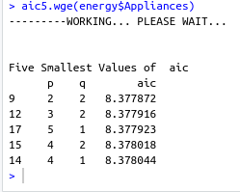
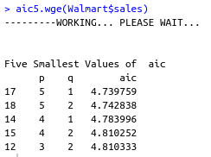
Top model Based on AIC Energy Data
According to the AIC5 function of the tswge, the top 5 models with the best AIC are:
ARMA(2,2)
ARMA(3,2)
ARMA(5,1)
ARMA(4,2)
ARMA(4,1)
Top model Based on AIC Walmart Data
According to the AIC5 function of the tswge, the top 5 models with the best AIC are:
ARMA(5,1)
ARMA(5,2)
ARMA(4,1)
ARMA(4,2)
ARMA(3,2)

Slide 3
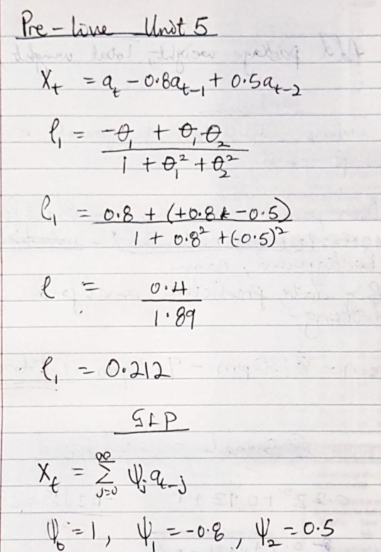
Question 2

Slide 4
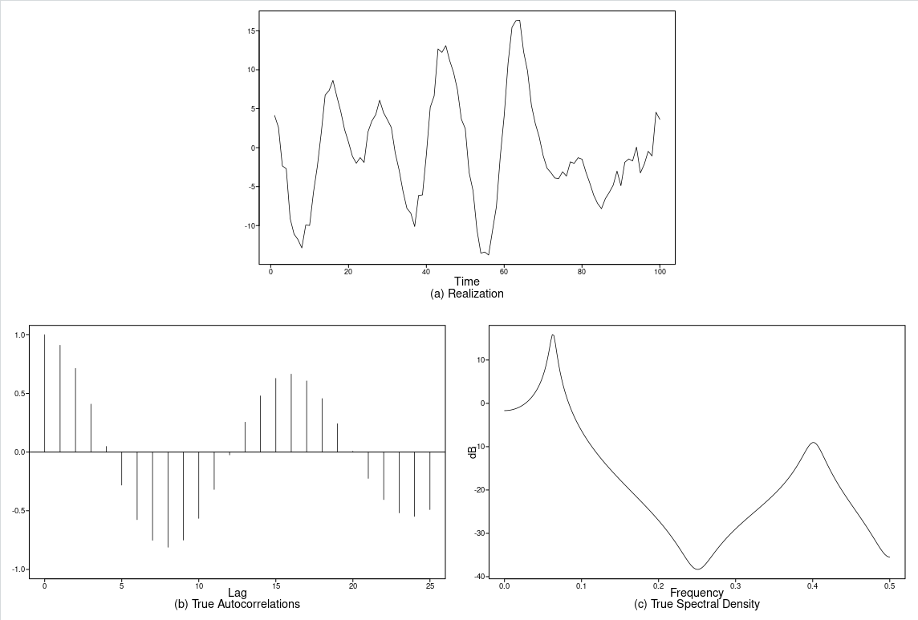
ARMA Model Realization

Slide 5
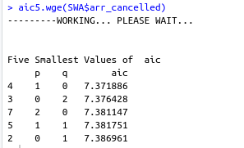
Cancelled Flight Data
The first model is AR(1) model
The second is MA(2) model
The third is AR(2) model
The fourth is ARMA(1,1) model
The fifth is MA(1) model

Slide 6
Takeaways
MA processes are not appropriate for modeling many real-world processes. MA behavior is most useful in the formation of ARMA(p,q) models.
φ(B) and Θ(B) introduce characteristics of the same type as in the AR(p) and MA(q) cases.
φ(B)X_{t} = Θ(B)a_{t} is a stationary and invertible ARMA(p,q) process if:
  Roots of φ(z) = 0 are outside the unit circle
  Roots of Θ(B) = 0 are all outside the unit circle
ARMA models are required to be stationary and invertible.
ACFs and spectral densities of ARMA models are combinations of their individual AR and MA components with more emphasis given to factors with roots closer to the circle.
A stationary and invertible ARMA(p,q) model can be written in the two forms:
  A GLP (infinite order MA)
  Infinite order AR

Slide 7
Questions
With respect to invertibilty of ARMA, could you have factors that are very close in come to each other eg 0.88 vs 0.87 break the invertibility of the model?
I wasn’t clear about the GLP weights and how you represent a model in GLP form.

